Slide 1
Indian Student Association -NWMSU
Team - 04

Slide 2
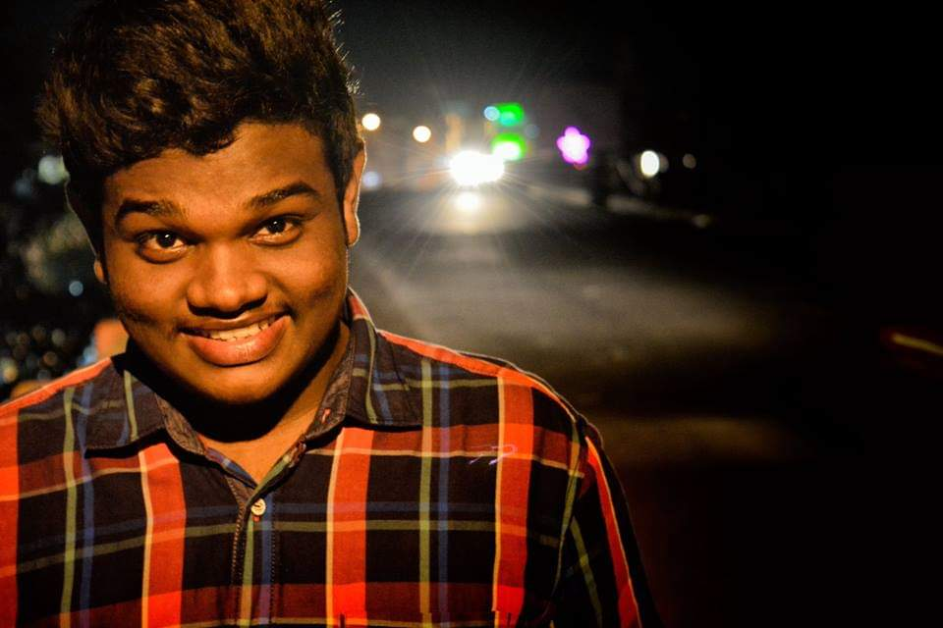
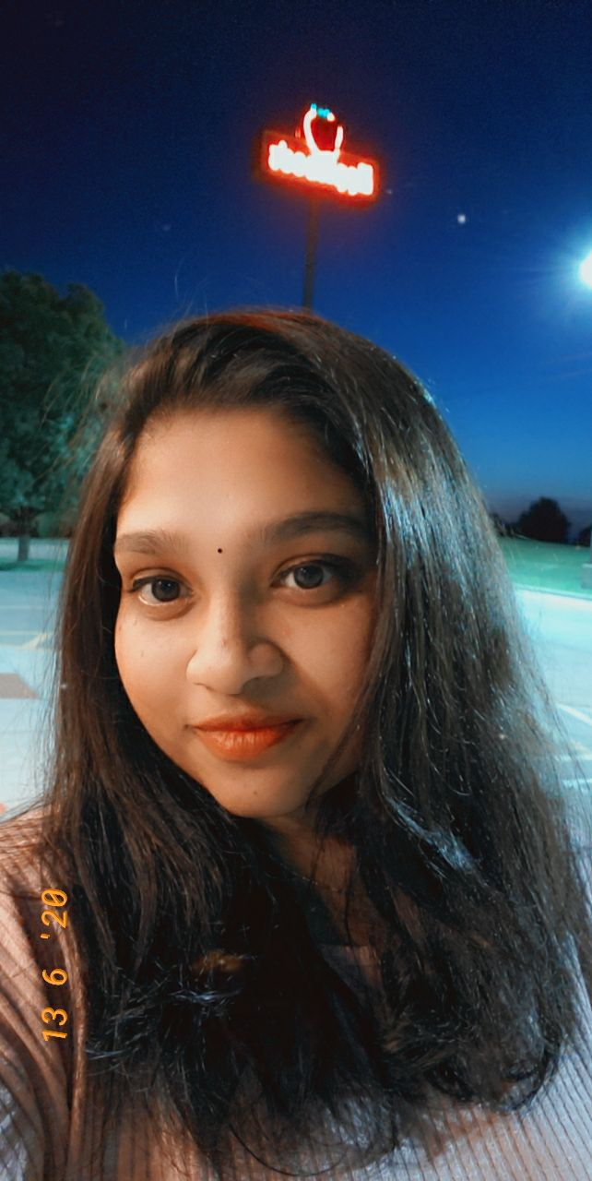
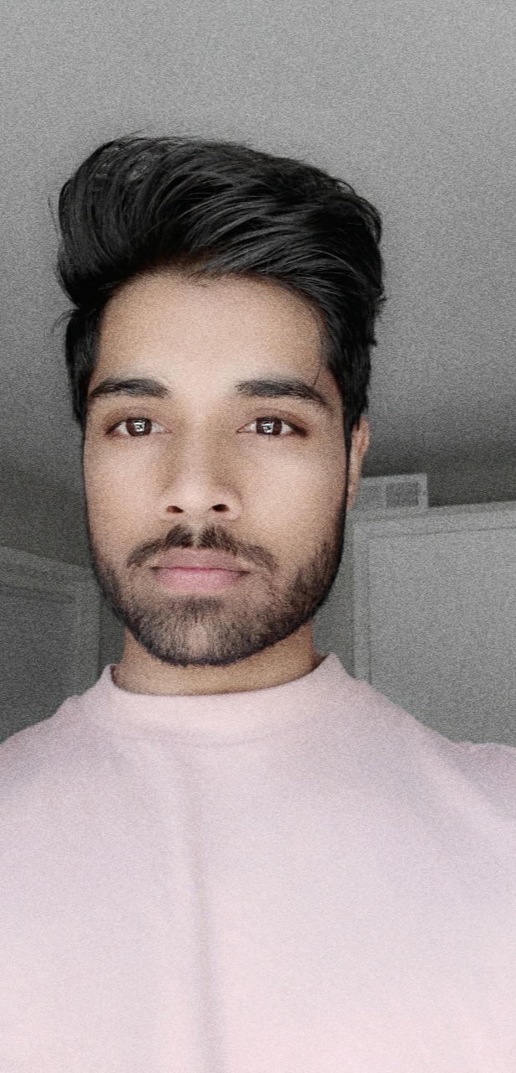
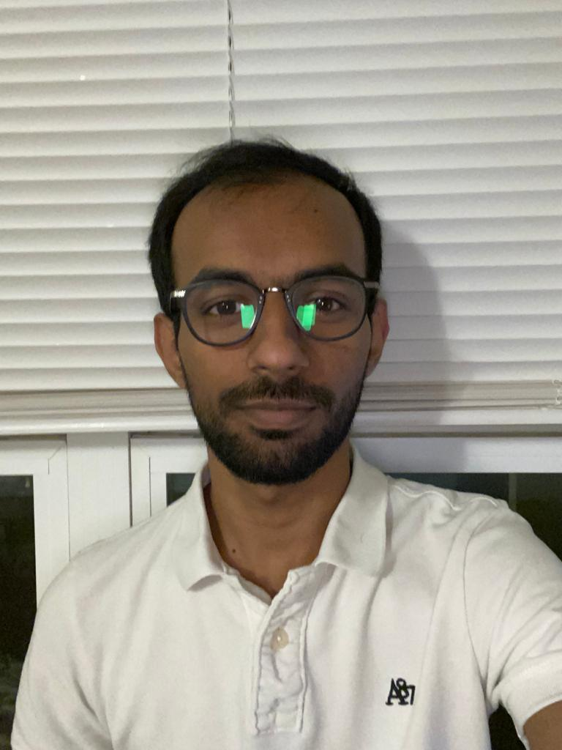
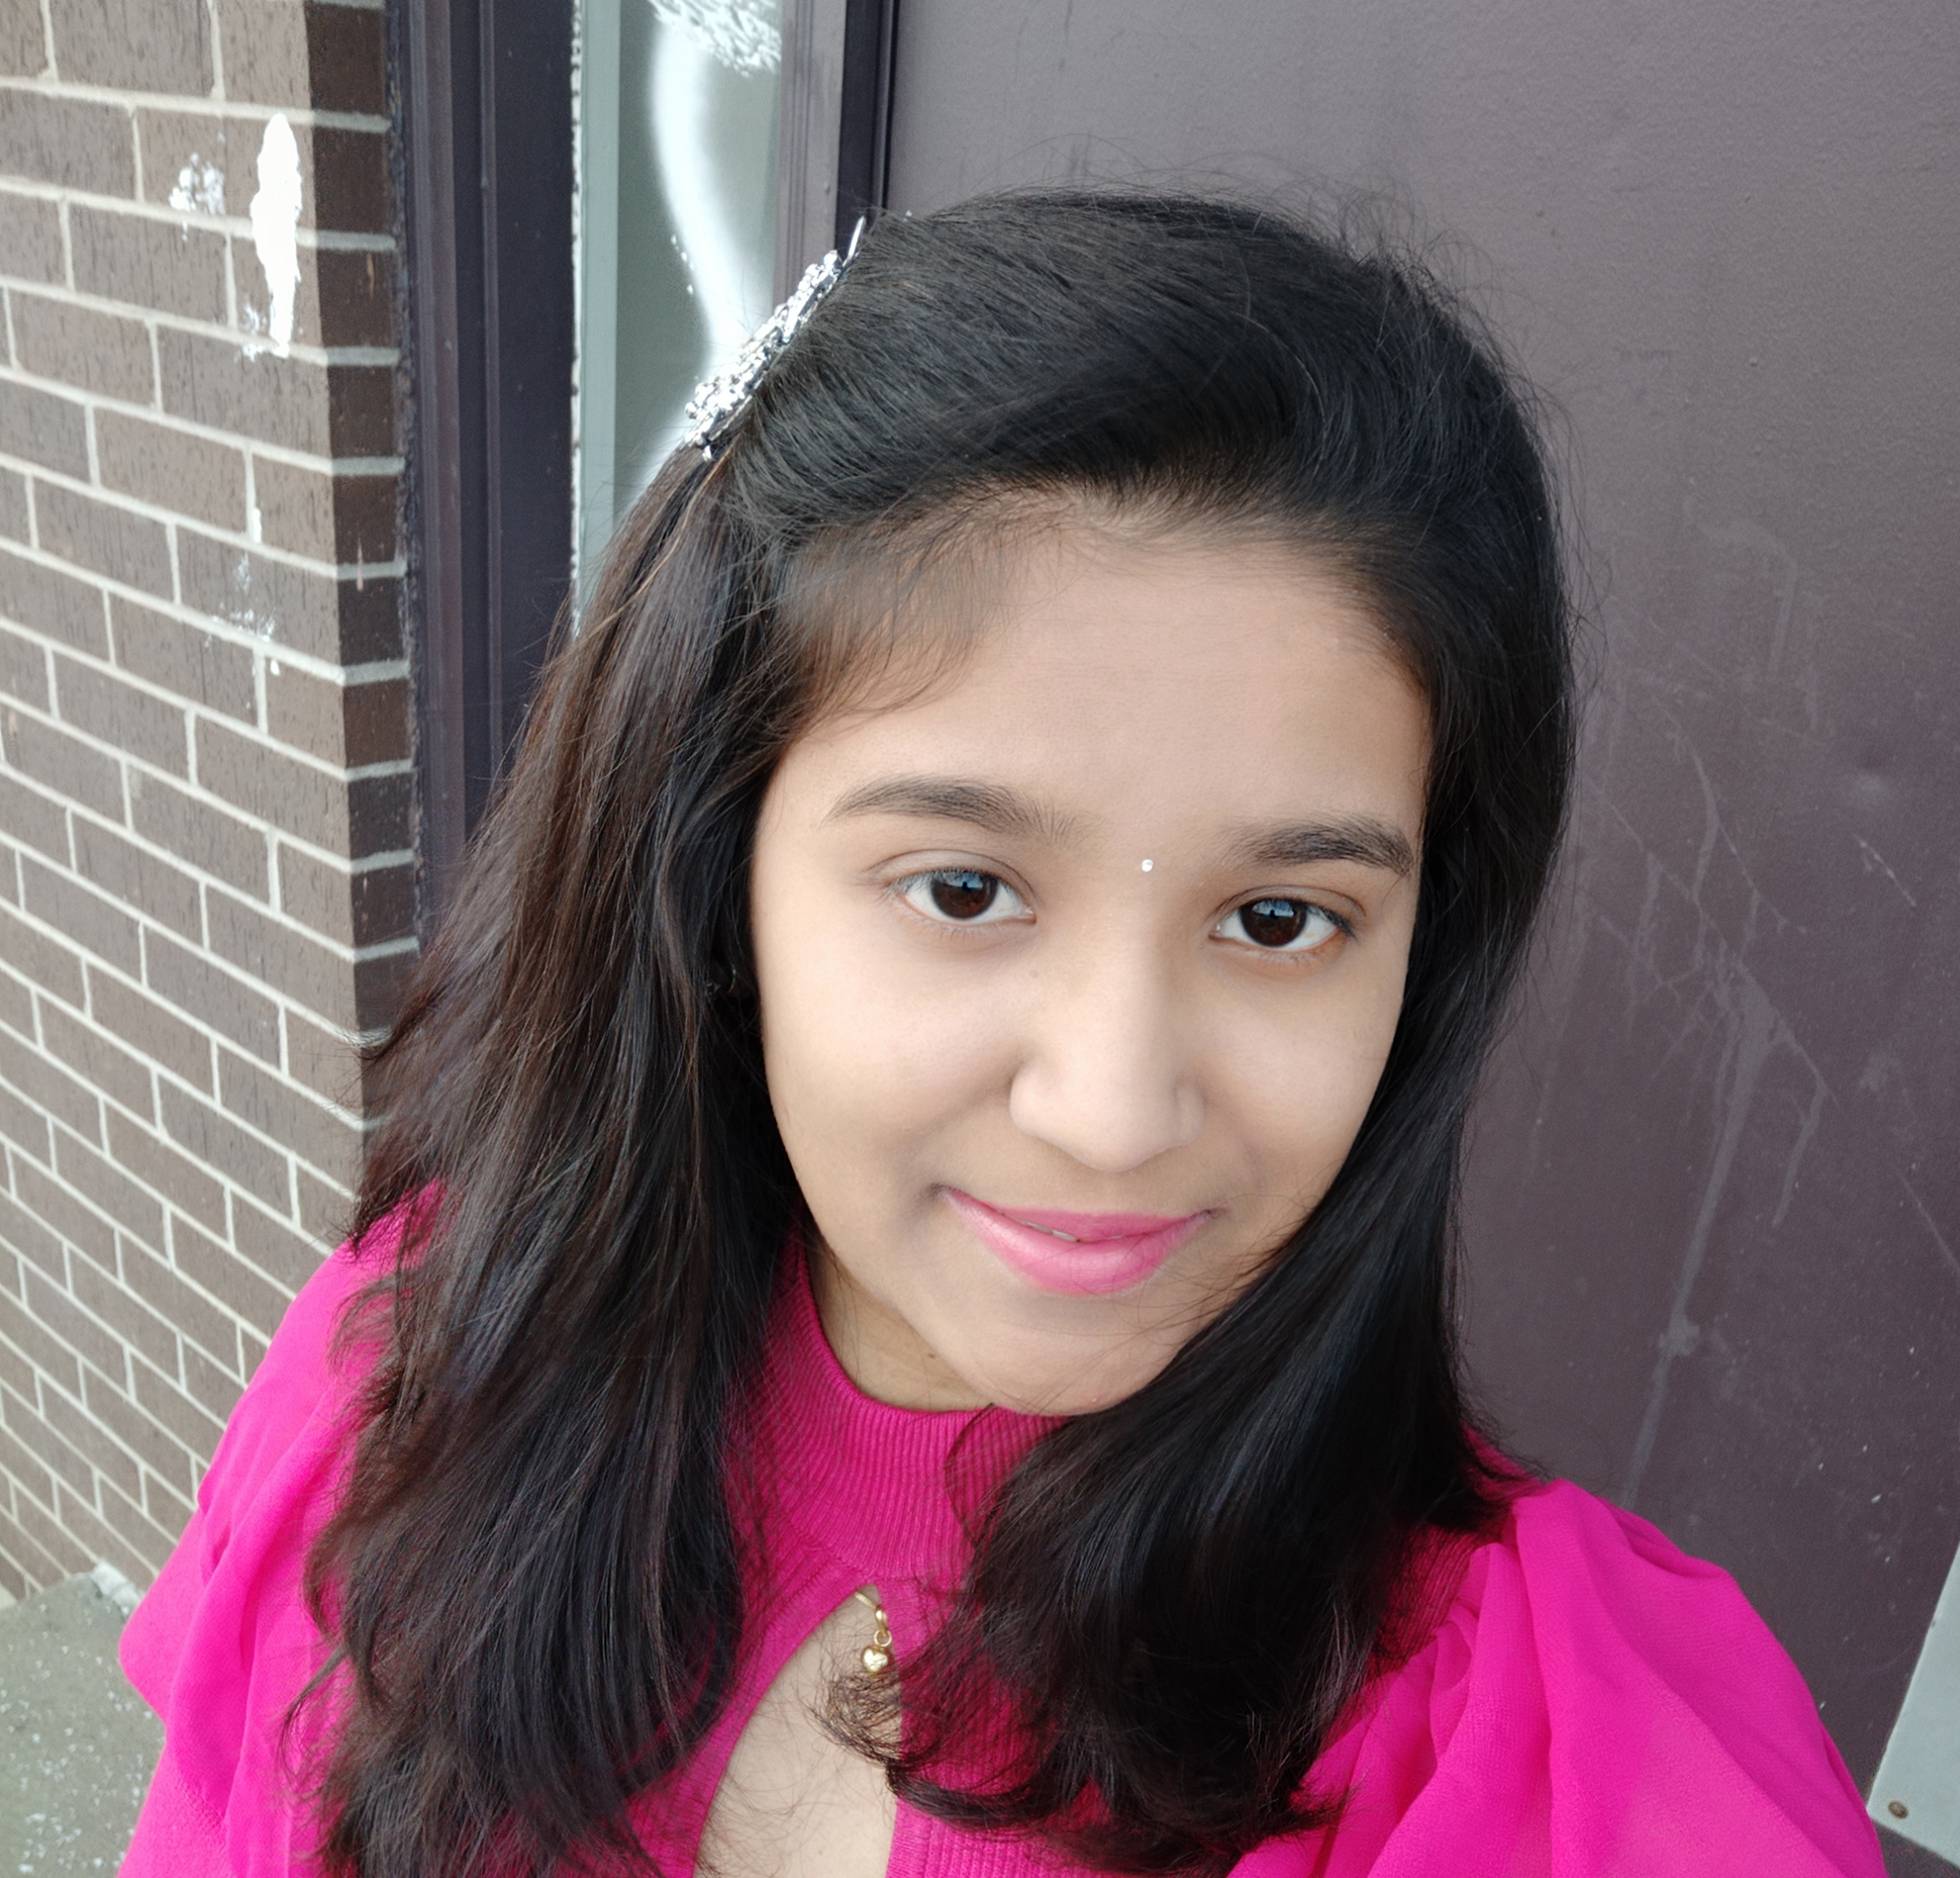
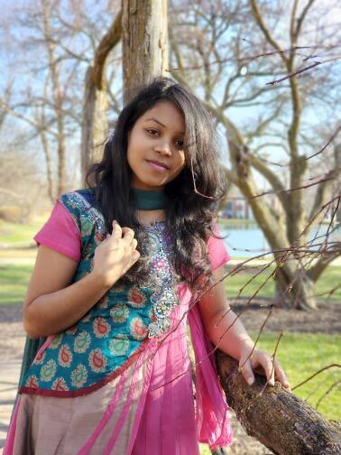
The Team
Dheeraj
Sai Jyothsna
Jeevan Reddy
Bharat Reddy
Bhavya Deepthi
Mahalakshmi

Slide 3
Outline
About the project
Problem statement
Solution
Intended users
Project Features
Project design
Software requirements
Hardware requirements
Summary

Slide 4
About the project
Indian Student association – NWMSU, is a web-based project which is targeted on the Indian community that attends Northwest Missouri State University.
This project is only being developed as a web application as of now and may be created as a mobile app in the near future.

Slide 5
Problem statement
No common platform to:
Respond to queries
Provide facilities to Indian students
Notify important info
Manage membership

Slide 6
Solution
Our application lets students to:
Request pickup, accommodation
Post queries online
Chat with the team, etc.
Our application lets ISA Team to:
Respond to student queries
Manage memberships
Manage events, etc.

Slide 7
Intended users
Guest
ISA Team
Students/Alumni

Slide 8
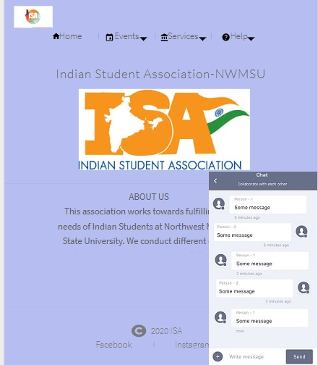
Launch Screen
Application’s home screen
Navigation pane

Slide 9
Pre login functionalities

Slide 10
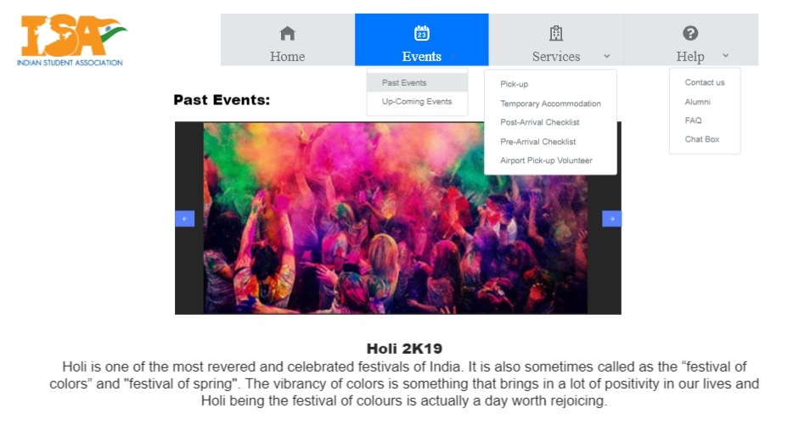
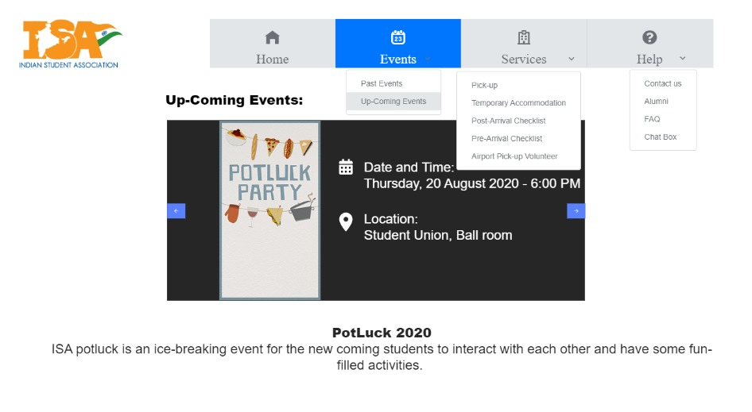
Events
Past events
Upcoming events

Slide 11
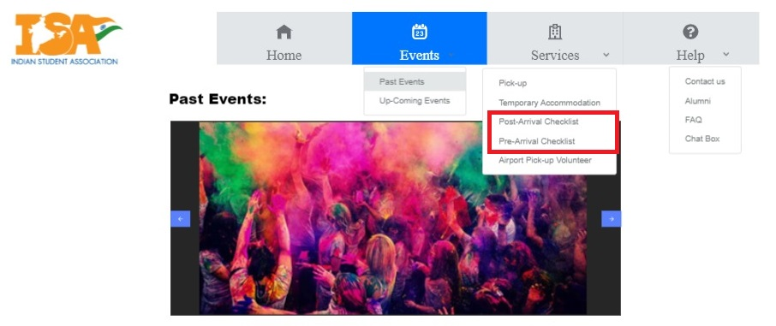
Services
Pre arrival checklist
Post arrival checklist

Slide 12
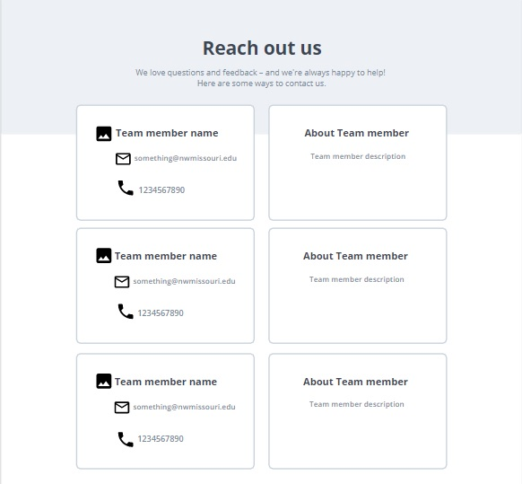
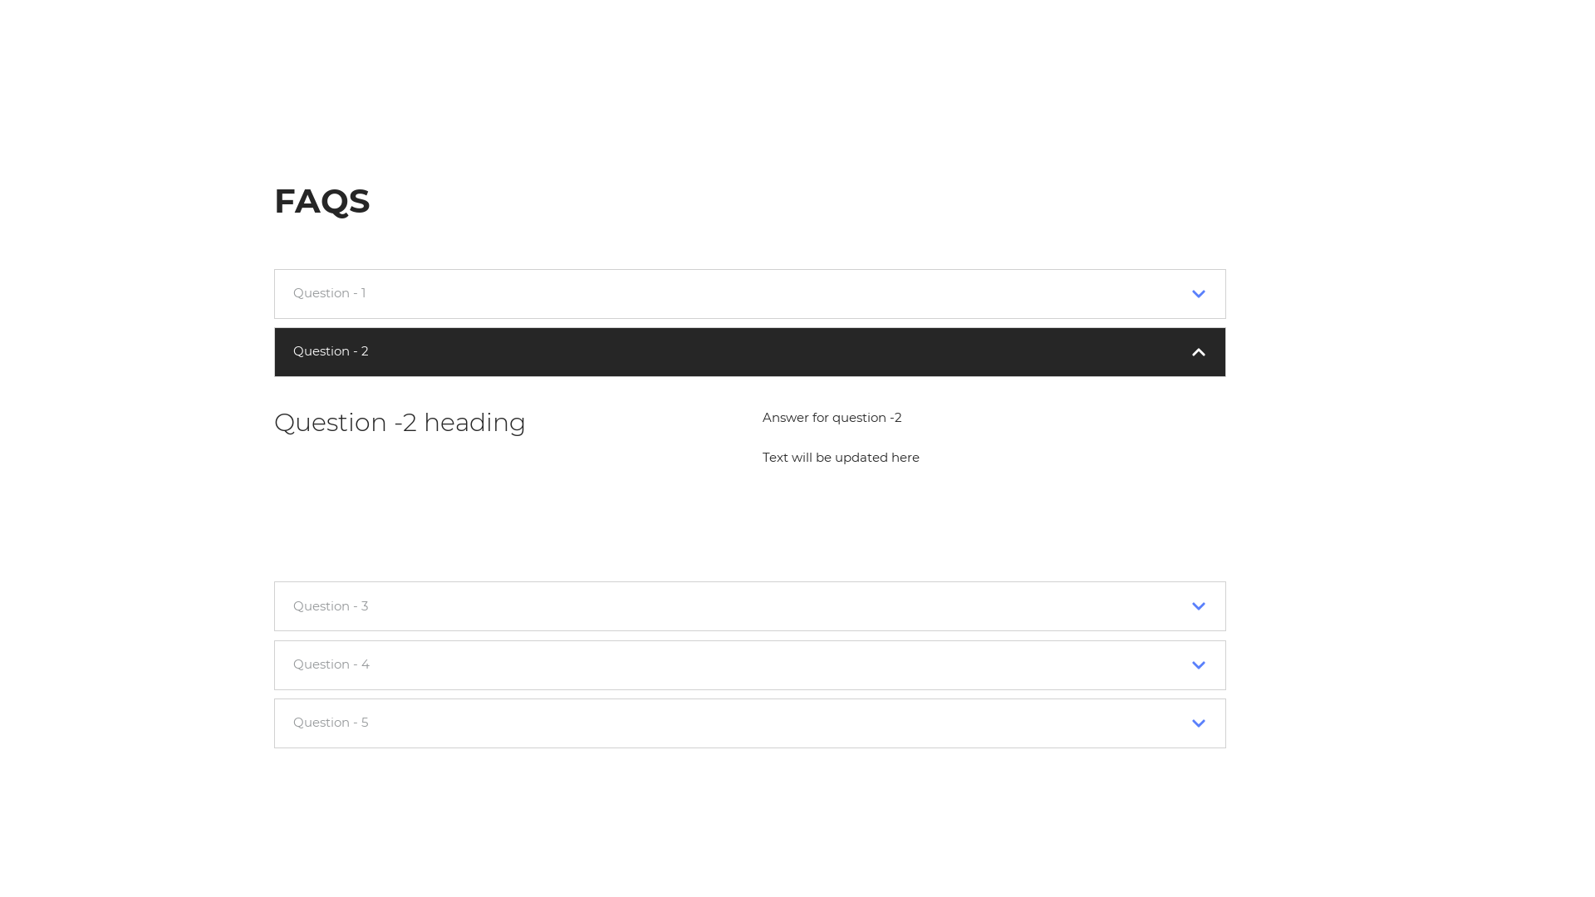
Help
Contact us
Alumni
FAQ

Slide 13
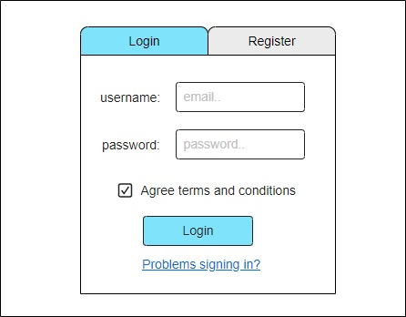
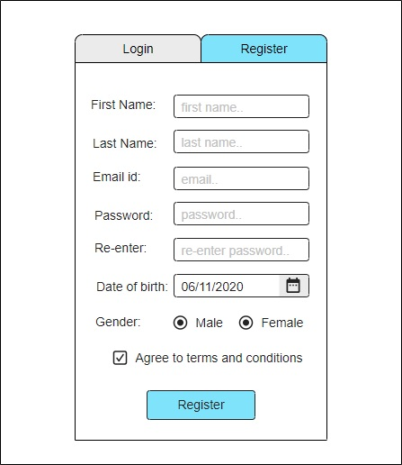
Login/ Signup
Login
Sign-up

Slide 14
Post login functionalities

Slide 15
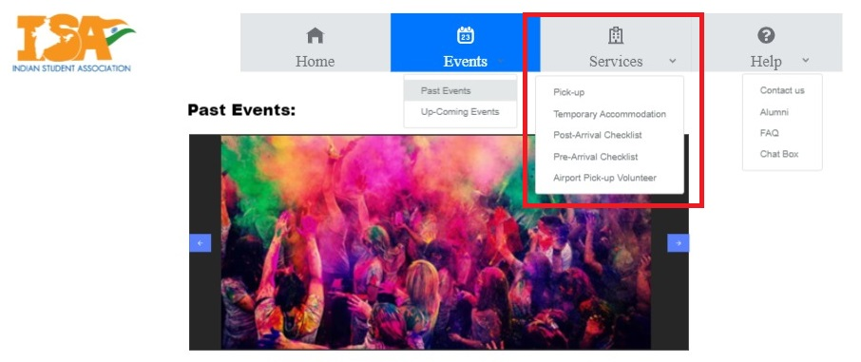
Services
Become a member
Request pickup
Request Temporary accommodation
Pre & Post arrival checklist
Volunteer services

Slide 16
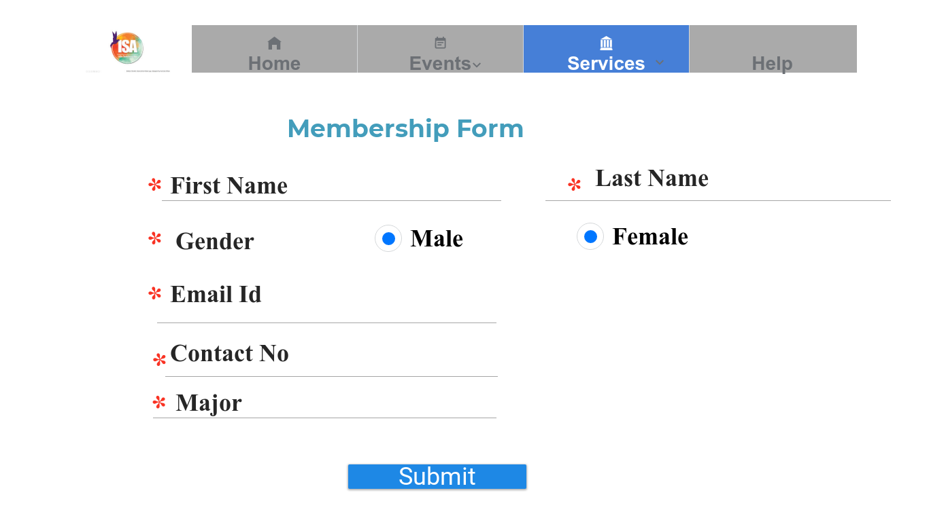
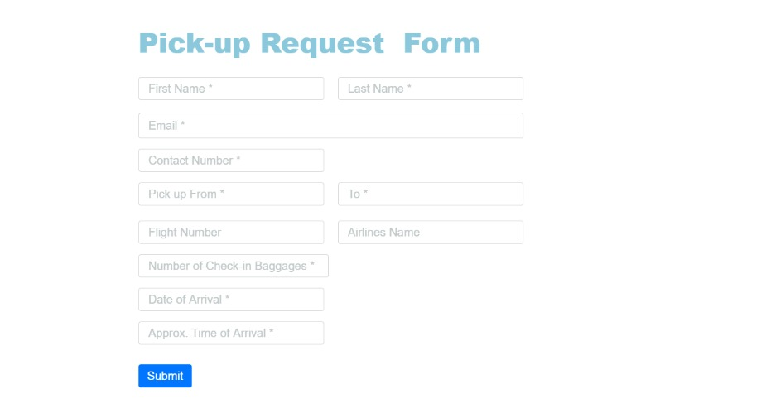
Services
Membership form
Pickup form

Slide 17
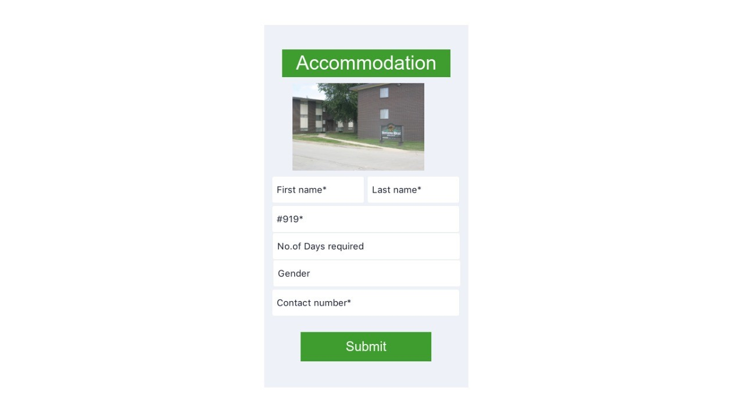
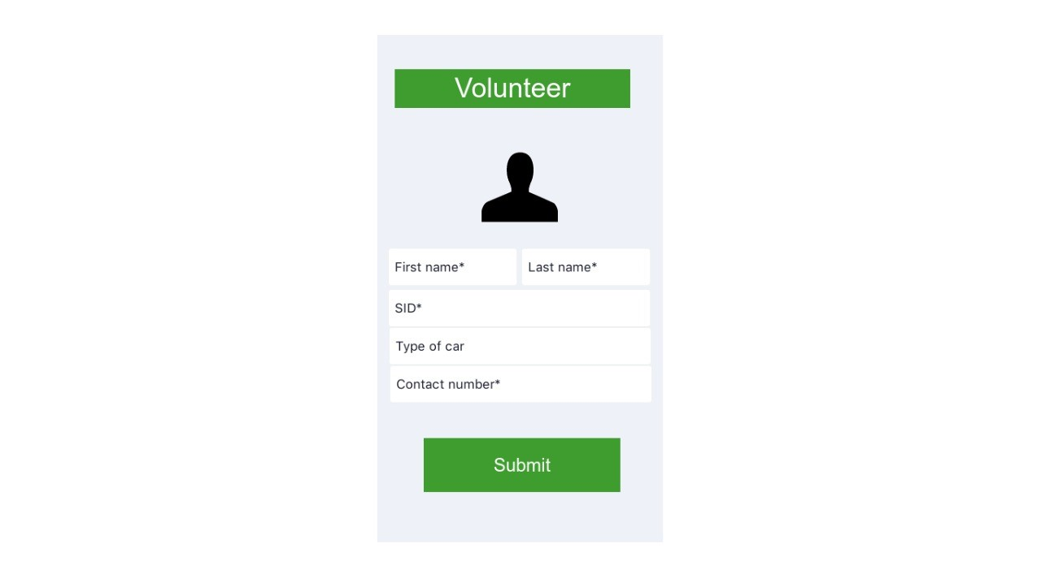
Services
Temporary Accommodation form
Volunteer form

Slide 18
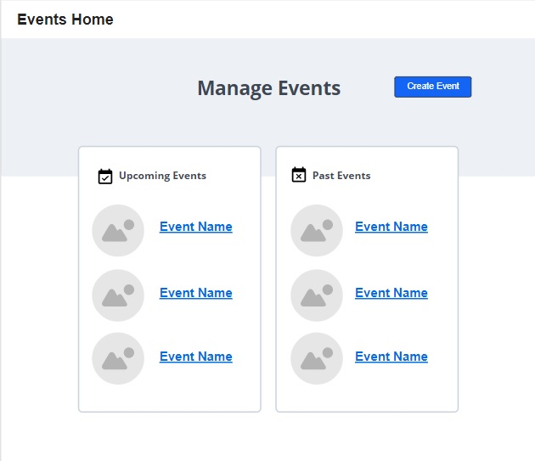
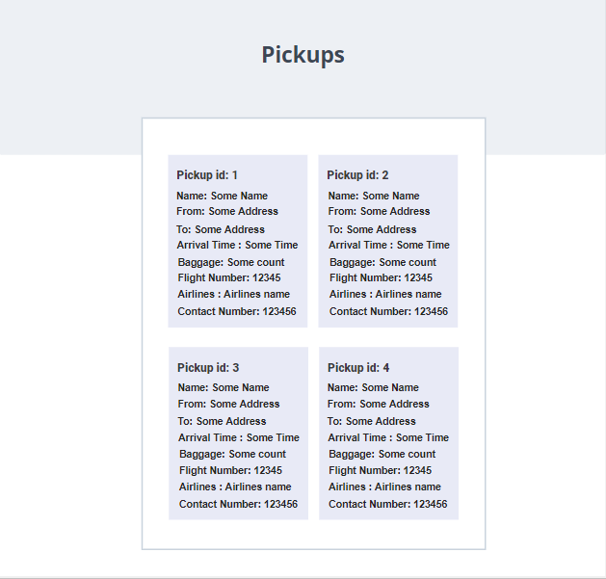
Admin features
Manage Events
View requests
Manage help page
Manage Forum

Slide 19
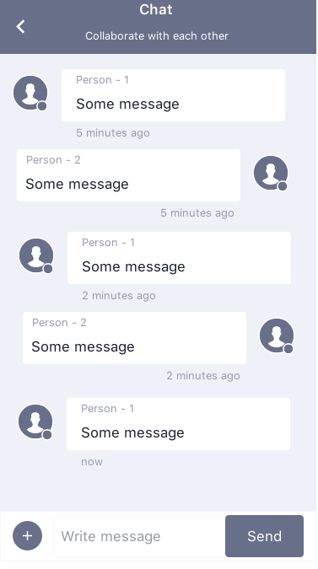
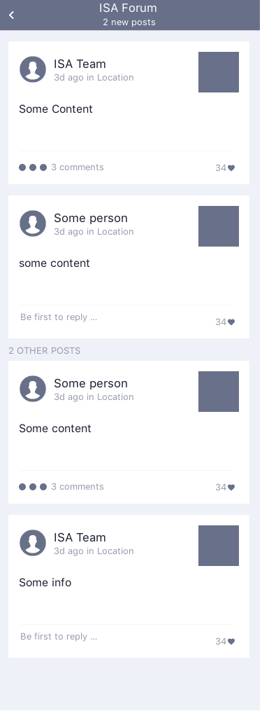
Other features
Chat box
Forum page
Notifications

Slide 20
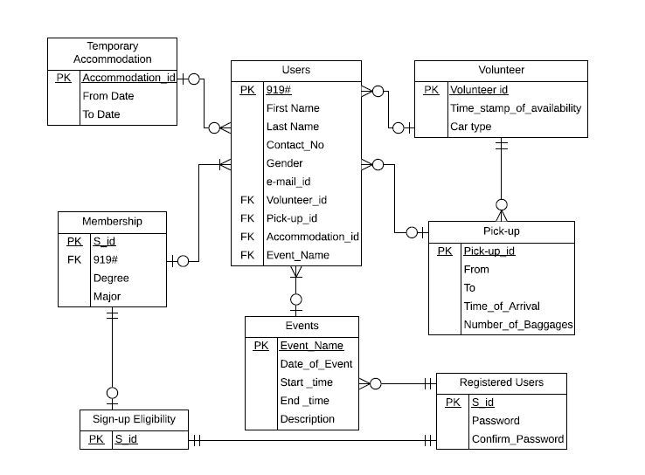
Project Design
Users entity
Volunteer entity
Pick-up entity
Events entity
Registered users entity
Sign-up entity
Membership entity
Temporary accommodation entity

Slide 21
Software Requirements
Front-end : React
Back-end : Node.js
IDE: Visual studio code
Database: Mongo DB

Slide 22
Hardware Requirements
Computers/ Laptops
Internet connection
Server

Slide 23
Summary
Our main intent of creating this project is to help the ISA team and the Indian community studying at Northwest.
We are sure this project helps Team ISA in better managing the organization.

Slide 24
Questions?
Dheeraj
Sai Jyothsna
Jeevan Reddy
Bharat Reddy
Bhavya Deepthi
Mahalakshmi

Slide 25
Thank You..

